Slide 1
INDUSTRIAL APPLICATIONS OF OPTIMIZATION
MULTI-PERIOD PRODUCTION PLANNING PROBLEM

Slide 2
TEAM MEMBERS
BHAVYA CHARITHA 21IM10012
BANDARI SHIKHARA 21IM10010
SALONI KUMARI 21IM10028
TRIPTI ROY 21IM30026
ARCHIE AVIRATI 21IM30004

Slide 3
Problem Statement
The problem is to develop a mathematical optimization model for production planning and inventory control of a company that produces multiple types of toys.
The goal is to determine the optimal quantities of each toy type to build and sell over a finite planning horizon, while meeting customer demand, inventory capacity, and production capacity, constraints, and minimizing a given objective function (e.g., maximizing profit, minimizing costs, etc.).

Slide 4
Formulation
Objective function
maximize ∑t∈ToyTypes ∑p∈Periods Sell[t][p] *
Toys[t].price
Constraints
∑p∈Periods ∑t∈ToyTypes InStockAtEndOfPeriod[t][p] ≤
MaxInventory
∑p∈Periods ∑t∈ToyTypes Sell[t][p] ≤ MaxDemand[t][p]
∑p∈Periods ∑t∈ToyTypes InStockAtEndOfPeriod[t][p] ≤ Toys[t].maxInventory
∑p∈Periods ∑t∈ToyTypes Sell[t][p] ≥ MinDemand[t][p]
∀t∈ToyTypes: ∑p∈Periods Build[t][p] = TotalBuild[t]
∀t∈ToyTypes: ∑p∈Periods Build[t][p] = TotalBuild[t]
∀t∈ToyTypes, p∈2..NbPeriods: InStockAtEndOfPeriod[t][p-1] + Build[t][p] = Sell[t][p] + InStockAtEndOfPeriod[t][p]

Slide 5
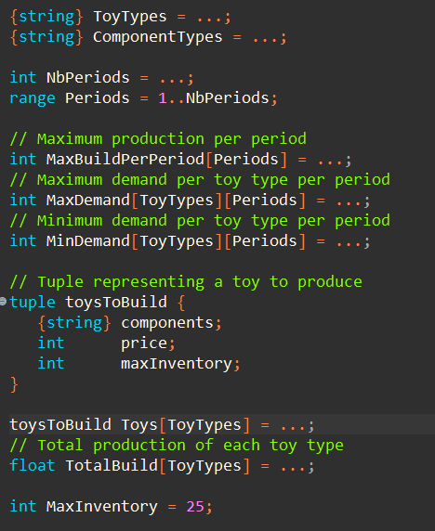
CPLEX Code
Defining data types

Slide 6
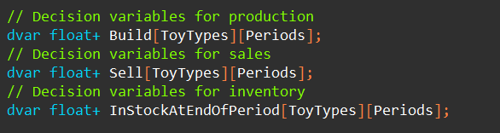
Introducing Decision Variables

Slide 7
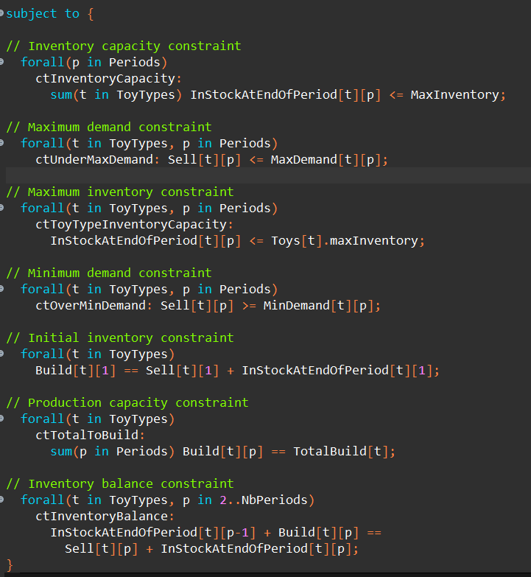
Constraints

Slide 8
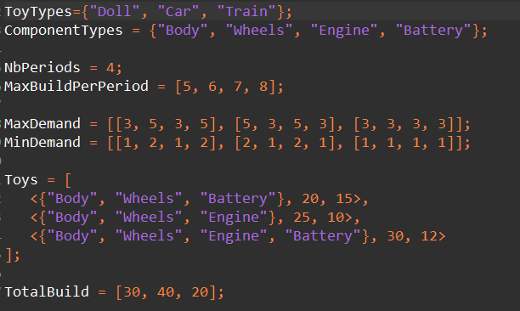
Data File

Slide 9
// Maximum Ax-b residual = 0
// Maximum |x| = 26
// Maximum |slack| = 25
//
InStockAtEndOfPeriod = [[0 0 0 14]
[0 0 0 3]
[0 0 0 8]];
Sell = [[3 5 3 5]
[26 3 5 3]
[3 3 3 3]];
Build = [[3 5 3 19]
[26 3 5 6]
[3 3 3 11]];
Output

Slide 10
THANK YOU!

